Slide 1
Warrior Academy Communication . Tools to Monitor student progress
Facilitator: Toya Jarrett

Slide 2
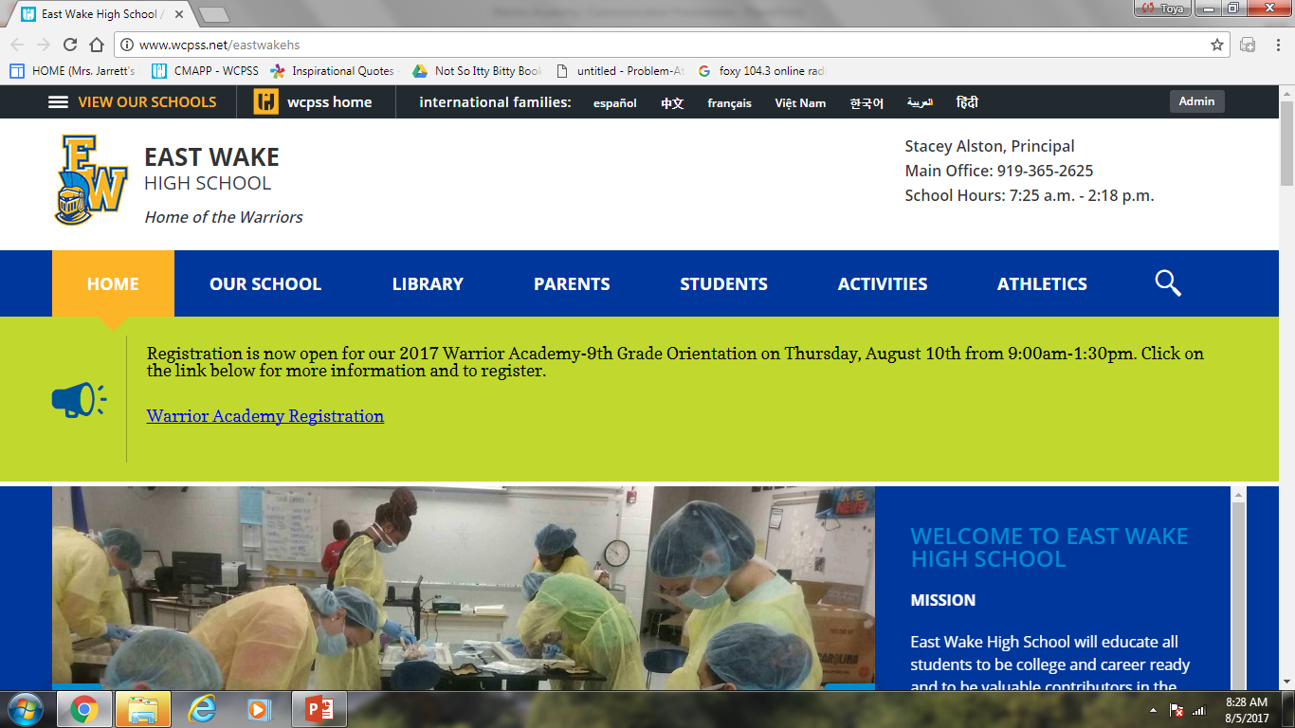
East wake high school website
http://www.wcpss.net/eastwakehs or Google “EWHS”

Slide 3
Newsletter
Found on the upper half of the EWHS Homepage

Slide 4
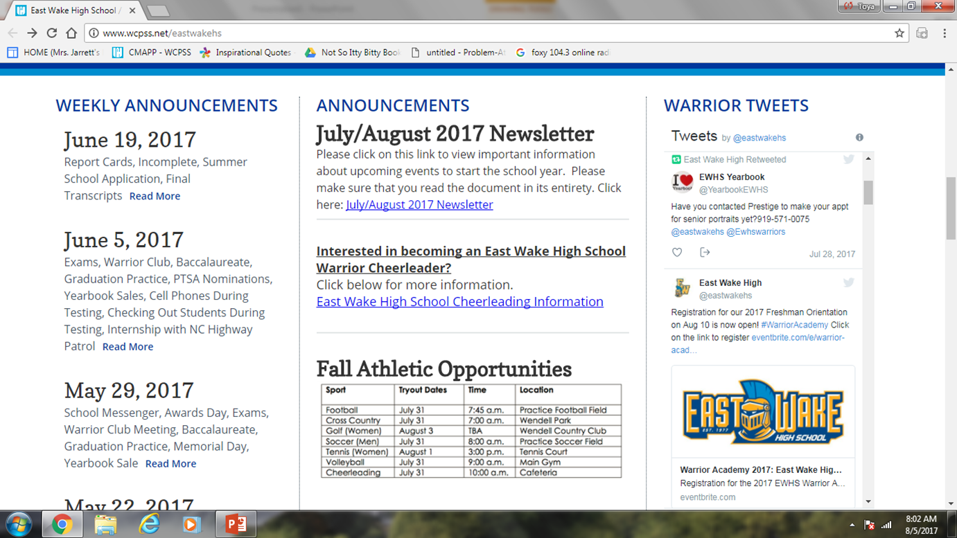
Weekly Announcements
EWHS Homepage
Email or Text

Slide 5
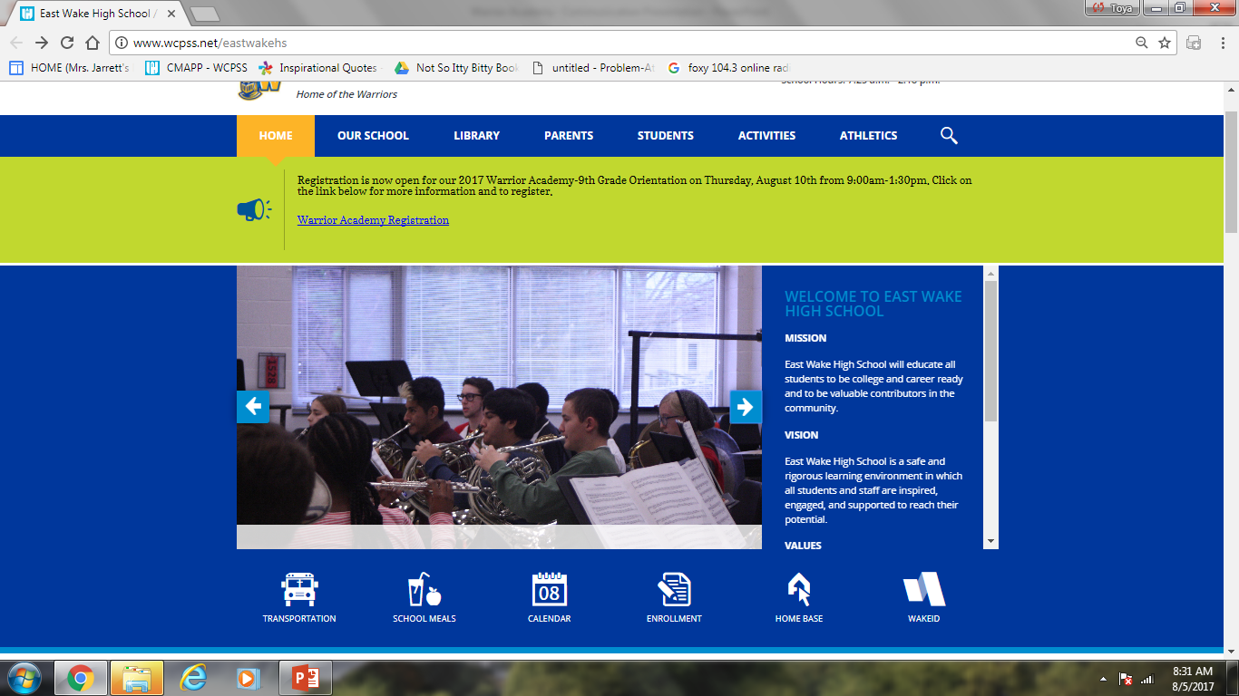
PowerSchool
Attendance and Grades
Click the HOME BASE link on the top half of the EWHS Homepage

Slide 6
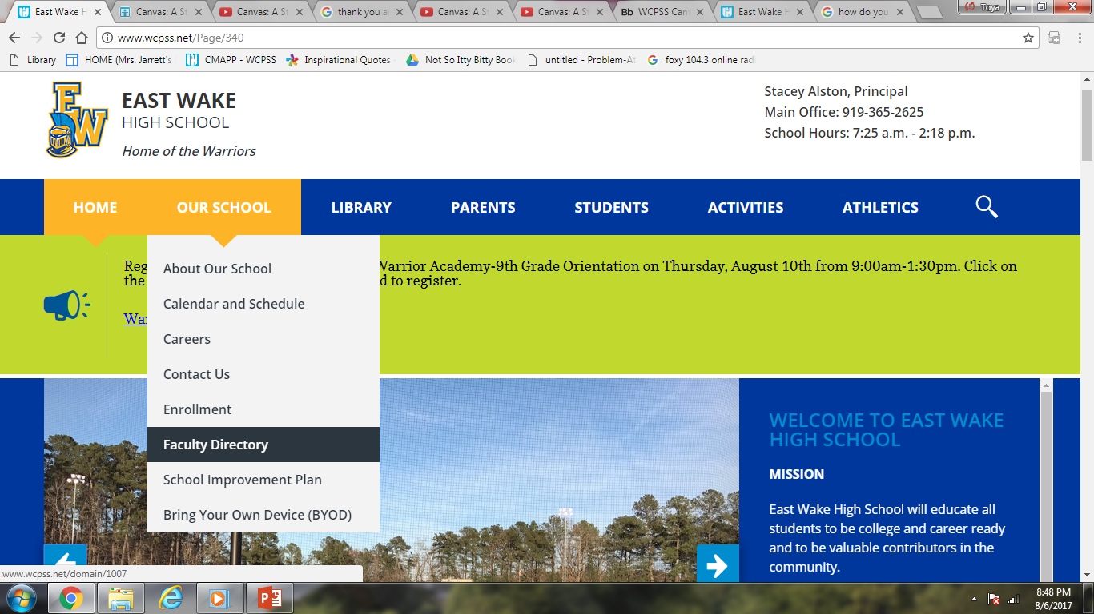
faculty Directory
Found on the EWHS homepage under the OUR SCHOOL tab at the top of the page

Slide 7
Remind
Remind is a free text messaging app that helps teachers, students, and parents communicate quickly and efficiently.

Slide 8
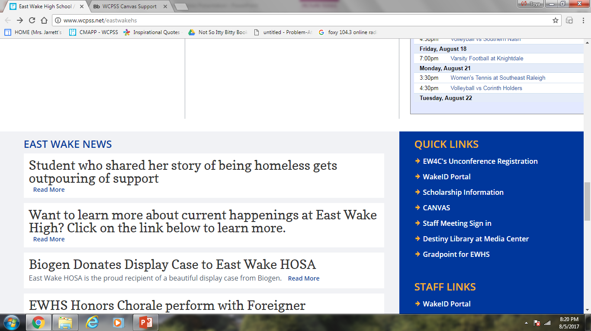
CANVAS
Coming Soon :
The public course syllabus page that will be shared on the EWHS website. The page will show the course syllabus and course calendar with assignments and assessments for each course.
Use your student’s login information for full access to course content which includes details about the assignments, modules, quizzes, grades, etc. ; your student’s school email address and password will be required.
Click for a canvas Overview
Begin video at 1:05 and stop at 6:00. WCPSS does not use the gradebook component in canvas. PowerSchool is used as our grading system.

Slide 9
Thank you for your time
&
Welcome to
East Wake High School

